Slide 1
跨越平台的（前）端技术
@十年踪迹

Slide 2
个人简介
月影（十年踪迹）
04年开始混前端，页面小白
喜欢研究算法，喜欢研究编程语言
对各种语言(C/C++、Lisp、JavaScript、Erlang、PHP、Python）多少玩过一些
08年开始参与设计 QWrap (http://qwrap.com/)
现在主要研究移动端开发，思考如何将PC前端开发的思路延续到移动端

Slide 3
提纲
移动前端 vs. 移动前端？
JavaScript + Web View +Native?
JavaScript + Scripting Core + Native?
UI、模板、服务：移动时代的端
面向多终端的“跨界”解决方案

Slide 4


Web & Mobile Systems
Web Page / Web App
Server
PHP、Python、Node……
Native App
PC
Mobile
DOM API
Android FM、Layout Sys
JavaScript Core
Java Core
Browser
DB
Device

Slide 5
Environments
Web App
Applications
Native App
HTML / Css
Markup Template Sys
Layout XML
Canvas / WebGL
UI FM/Controls
Native/OpenGL ES

Slide 6
Abilities
我有本地数据库
……
我能打电话
我能绘制2D/3D
我能实现UI
我能获取地理信息
我能本地存储
……
我能播放流媒体
我有HTML5
我有HTML5
我也能实现UI
我支持HTML5
我支持HTML5
我支持HTML5

Slide 7

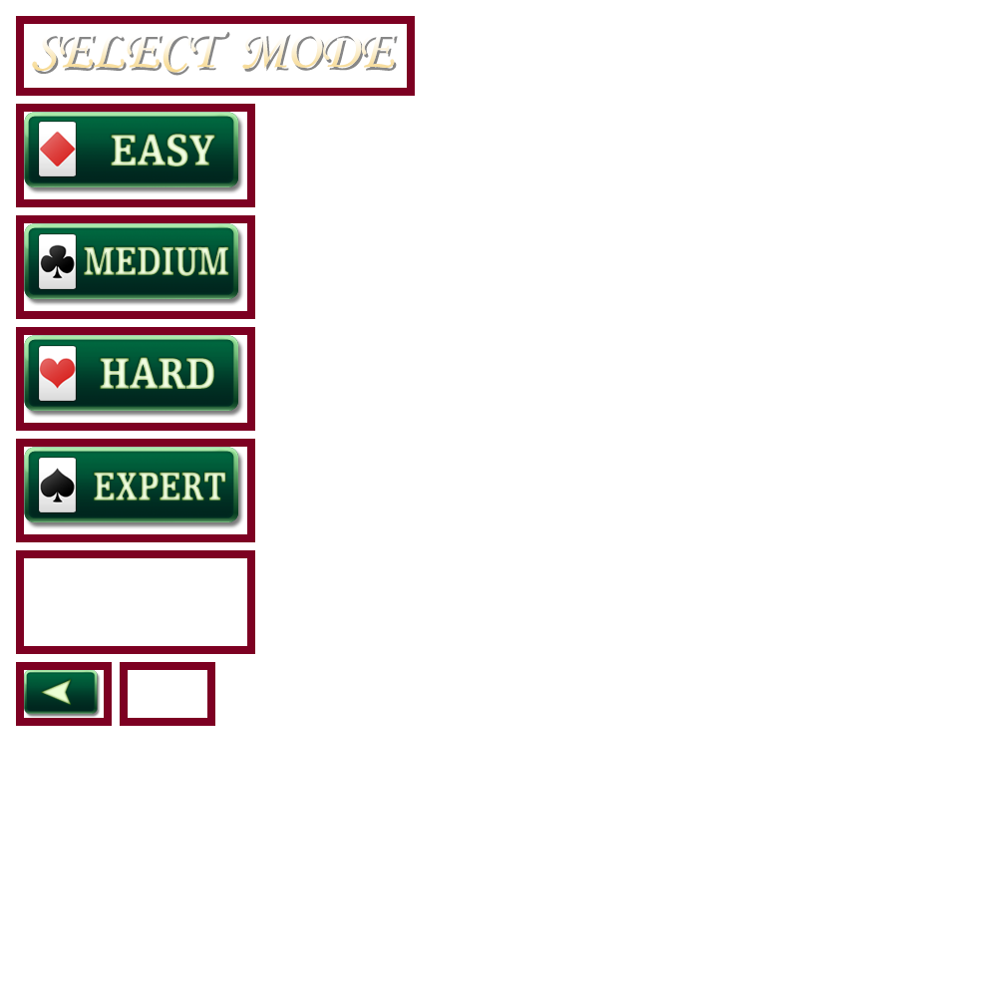
Workflows
切图
界面
交互
数据

Slide 8
Language gaps
alert(“Hi”)
……
System.out.println(“Hi”)
……

Slide 9


Scriptable
JavaScript
JavaScript
JavaScript
Rhino Scripting Engine
JavaScriptCore/JavaScriptCore.h
SpiderMonkey JavaScript bindings
Java Core
Objective C
C++

Slide 10
Android with Rhino
Scriptable Activity
create View
start Activity
bind events
init scope & exports
Connected with native
by message
Load JS & run

Slide 11
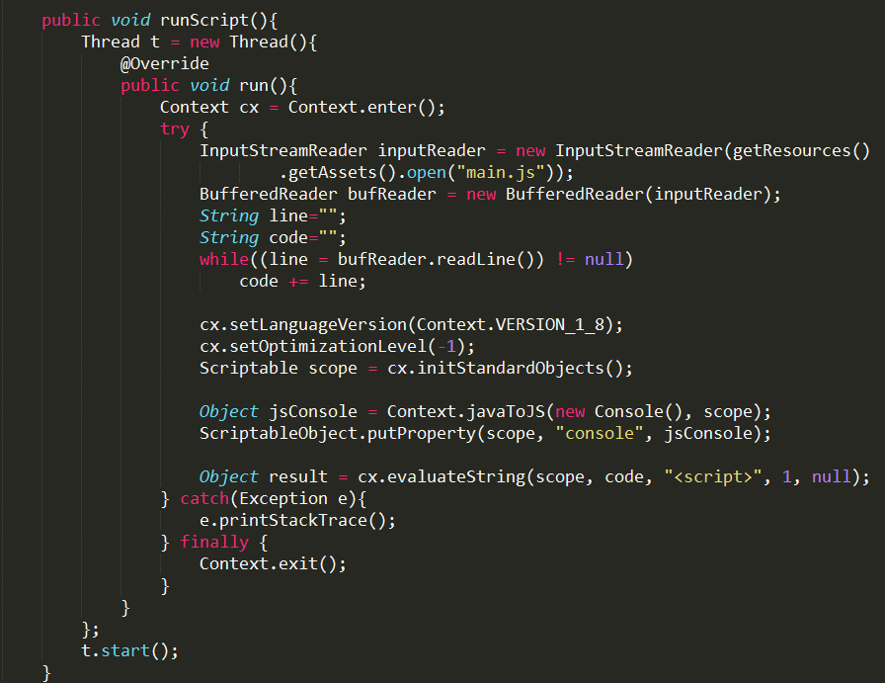
Android with Rhino: sample code

Slide 12


Cocos2d-x with JavaScript bindings
Game Code
Game Code
JS API Compatible with Cocos2d-html5
Browsers
Cocos2d JSB
JS Engine
JS Engine
Layout Engine
Canvas/WebGL
OpenGL ES 2.0

Slide 13
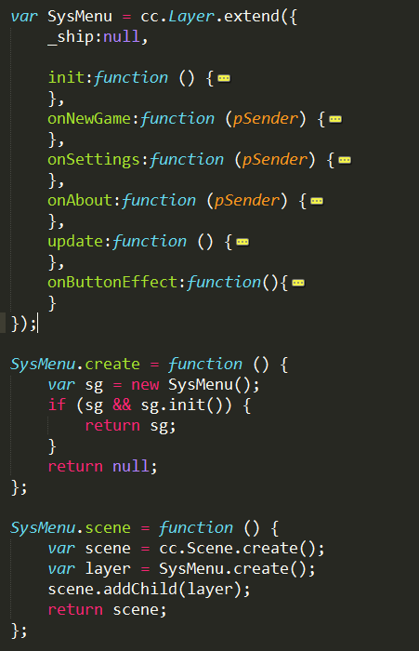
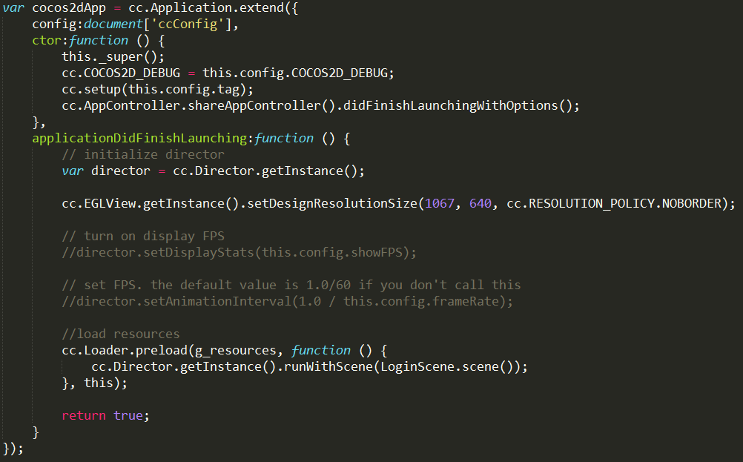
Cocos2d-x JSB: sample code

Slide 14
IOS 7 with JavaScript Core
http://shappy1978.iteye.com/blog/1899579

Slide 15
Another solution: Interact with embed Web
App Code
App Code
JS Framework
JS Framework
Browsers
UI WebView
Native
JS Engine
JS Engine
Layout Engine
Layout Engine
Canvas/WebGL
Canvas/WebGL

Slide 16
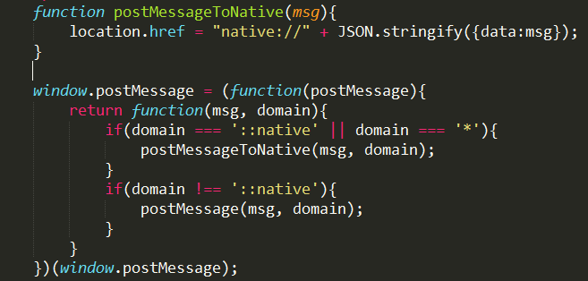
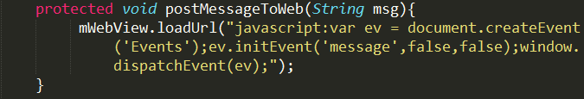
Interact with web on Android

Slide 17
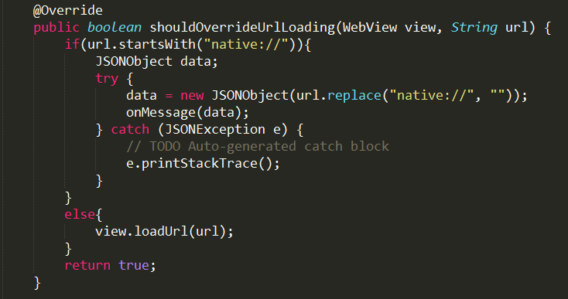

Messages between android native & web

Slide 18
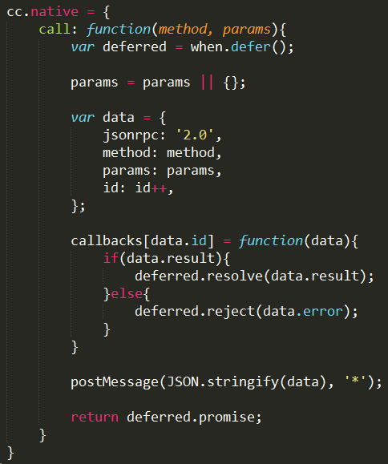
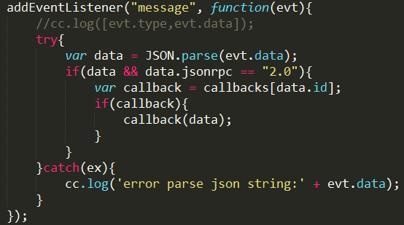

Communicate with JSON-RPC
http://www.json-rpc.org/

Slide 19
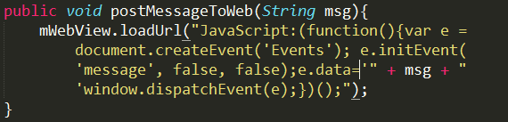
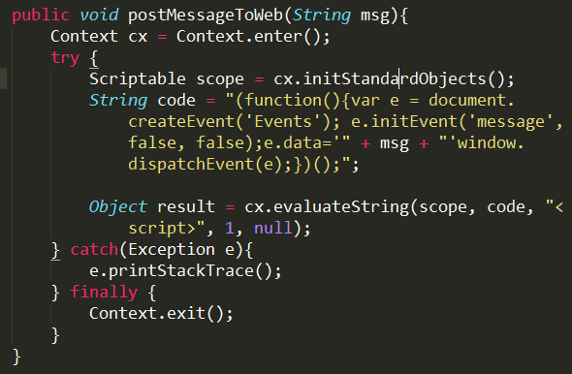
Non-web solutions

Slide 20
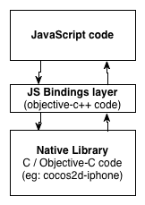
Export native APIs to JS directly
https://github.com/zynga/jsbindings
https://github.com/kripken/emscripten

Slide 21

Phonegap / Cordova
http://docs.phonegap.com/en/2.9.0/index.html

Slide 22
Performance: Web Embed
Test sprites: 50
web : 60fps
iphone 4s/5: 40~60fps (phonegap)
android: 10+ fps (phonegap)
windows phone 8: 10+ fps (phonegap)

Slide 23
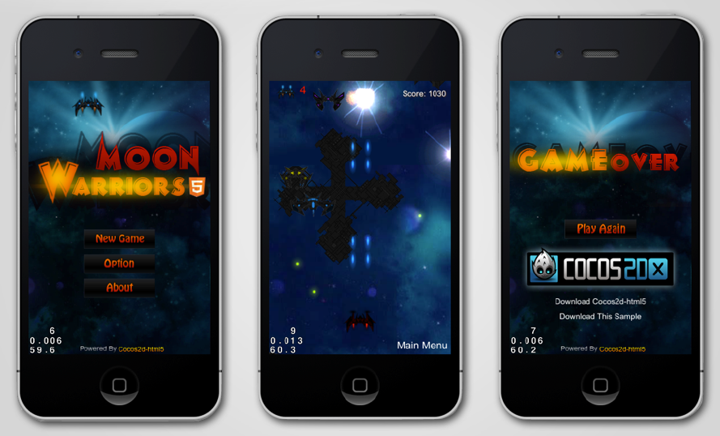
Performance: cocos2dx with JSB

Slide 24
Web vs. Non-web (JavaScript only)
 | Web Embed | Non-Web
HTML | O | XX
CSS | O | XX
JavaScript | O | O
HTML5 Compatible | O | O
Performance | X | O
Cross Platform | O | O

Slide 25
The future
App
Game
Applications
JavaScript Framework
Base FM
Native Template System
Web view
Game Framework
Render Sys
Scripting Core
Scripting Core
OpenGL ES
Direct 3D
Canvas/webGL
Graphic Sys
iOS
android
windows phone
web browser
Platforms

Slide 26
Thanks ~
Q&A

